Slide 1




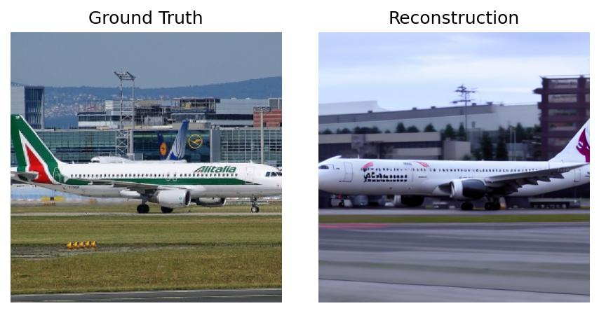


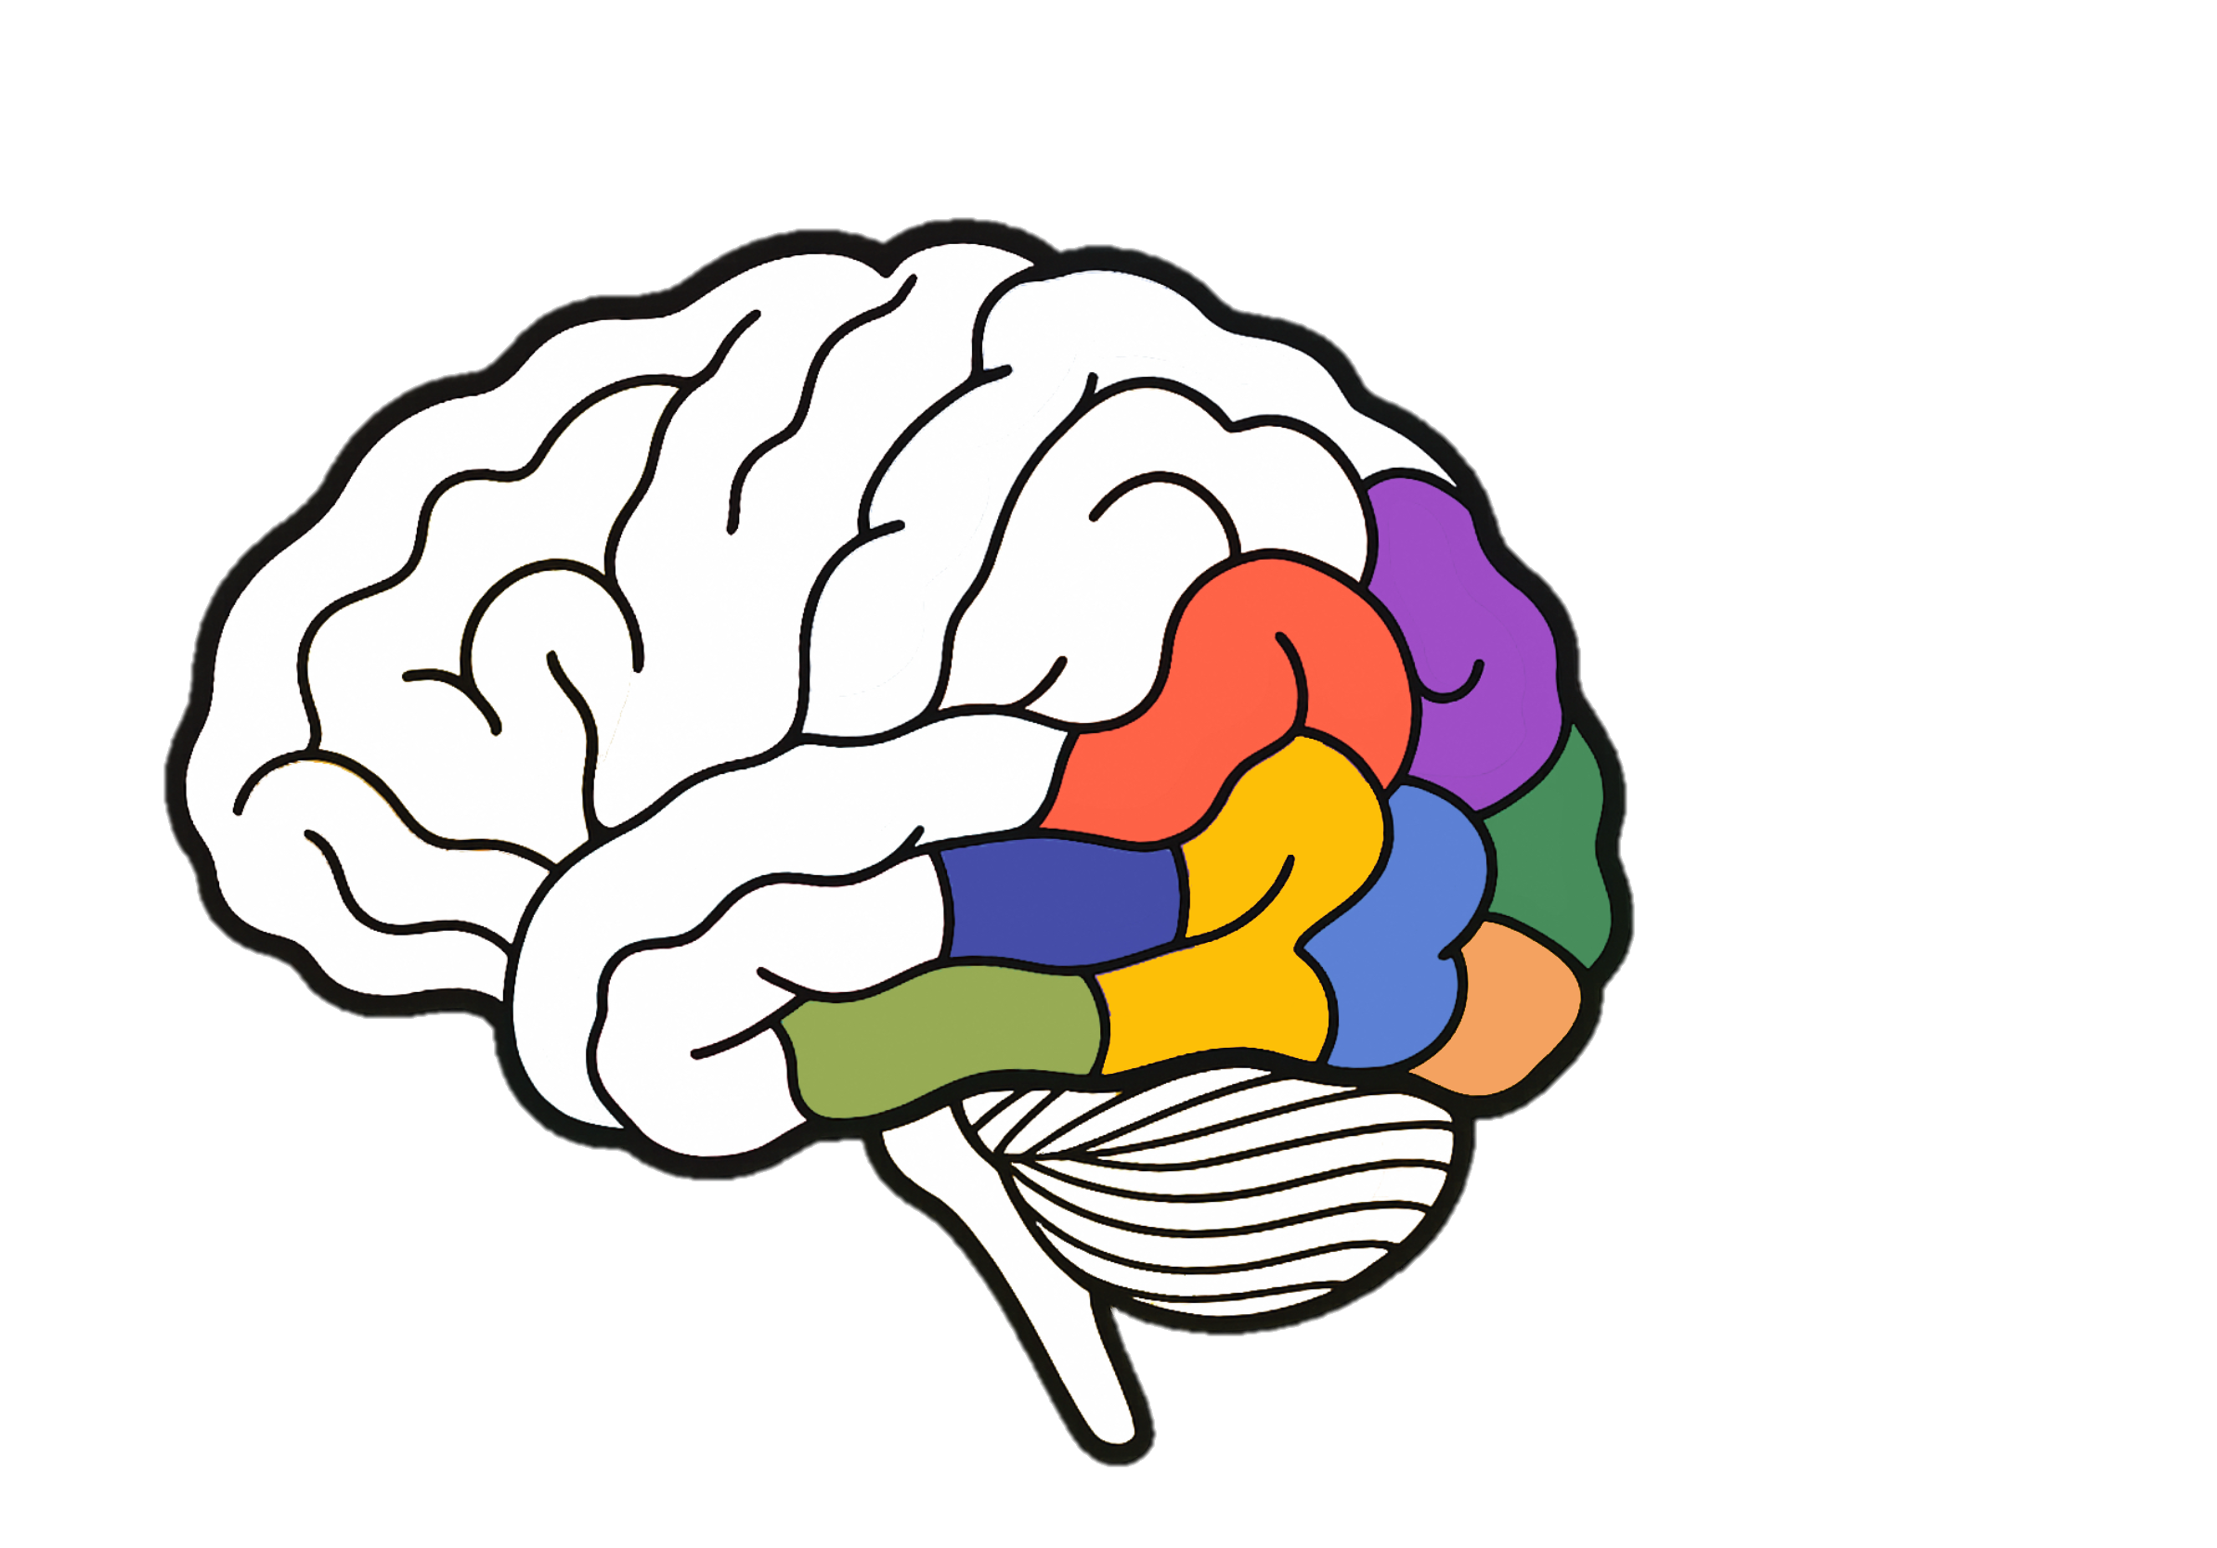






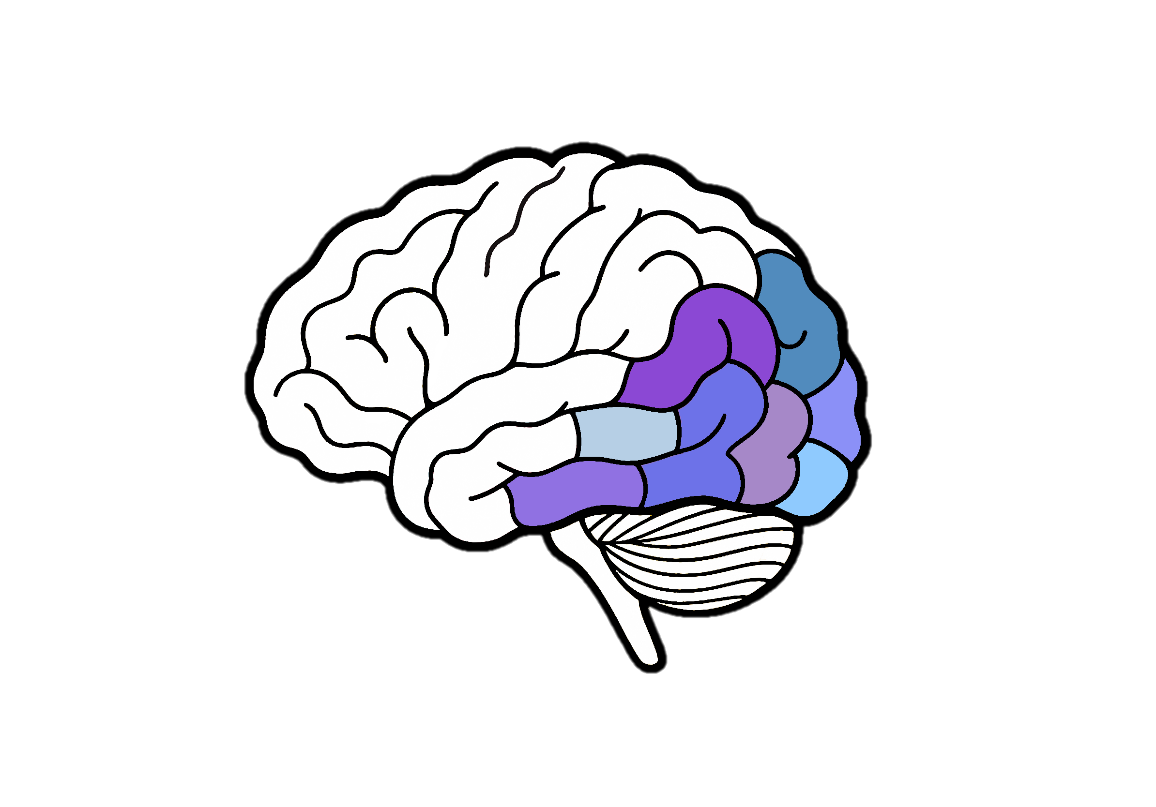
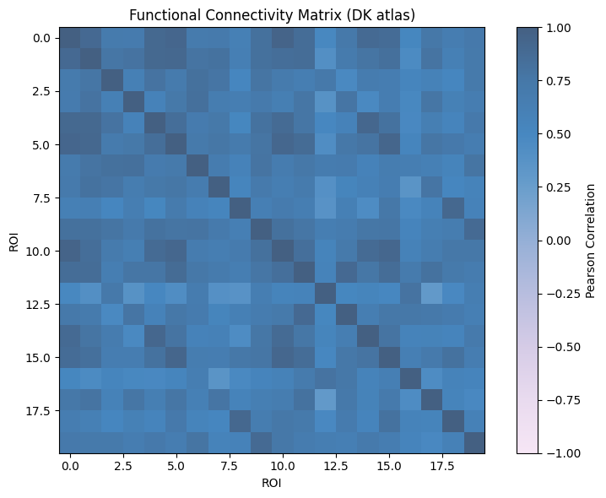



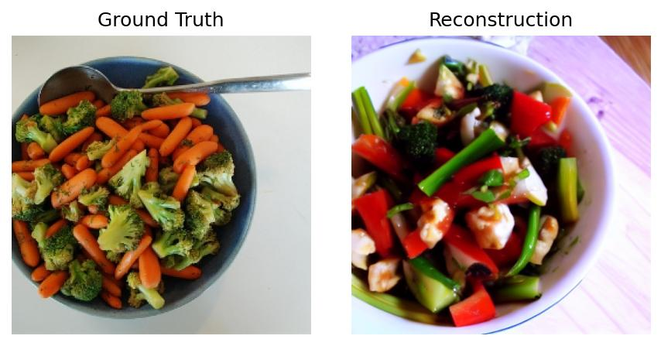
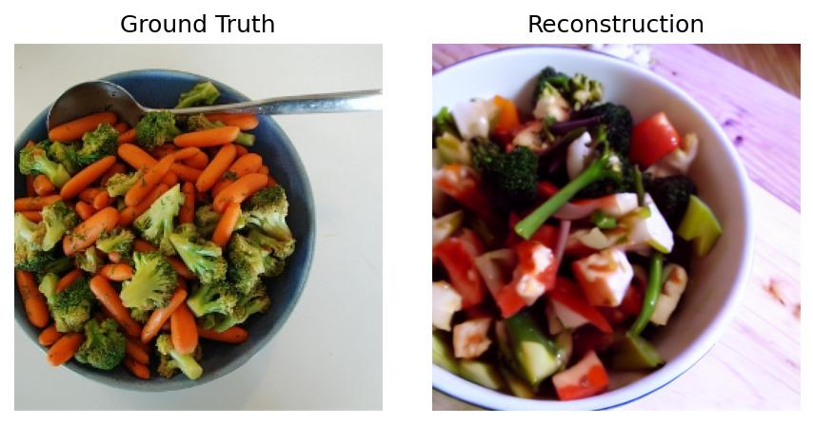
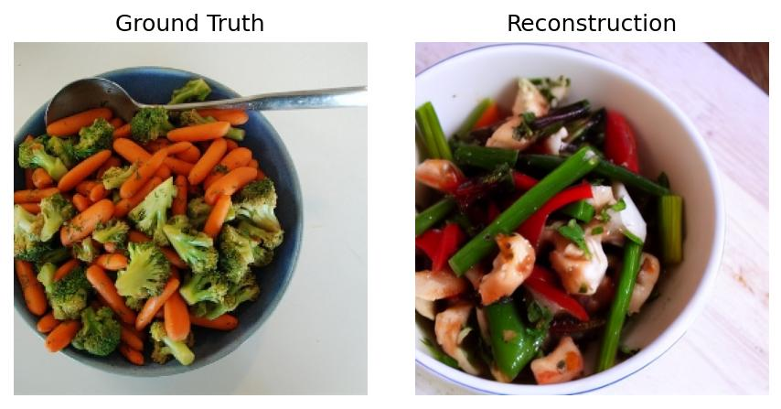
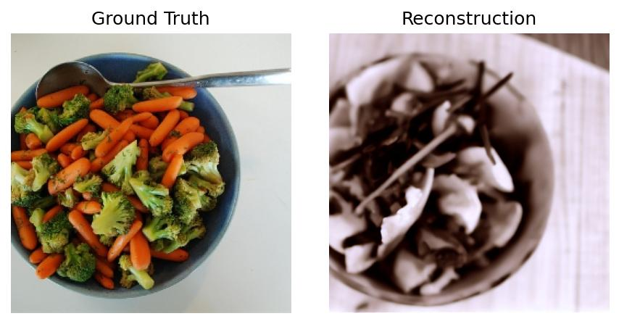
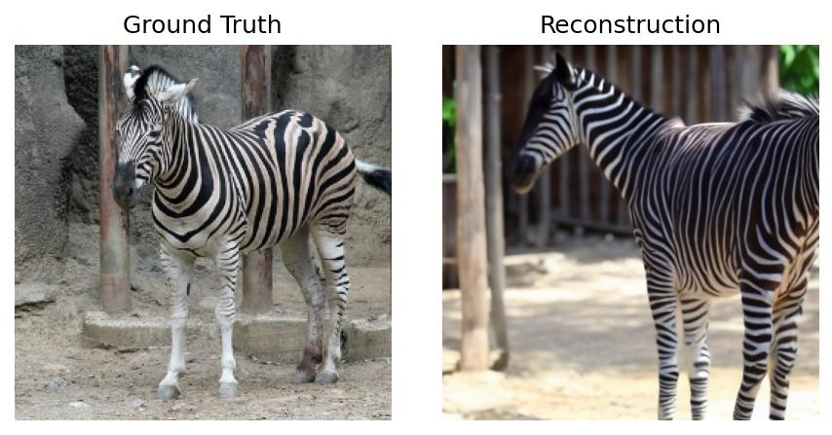
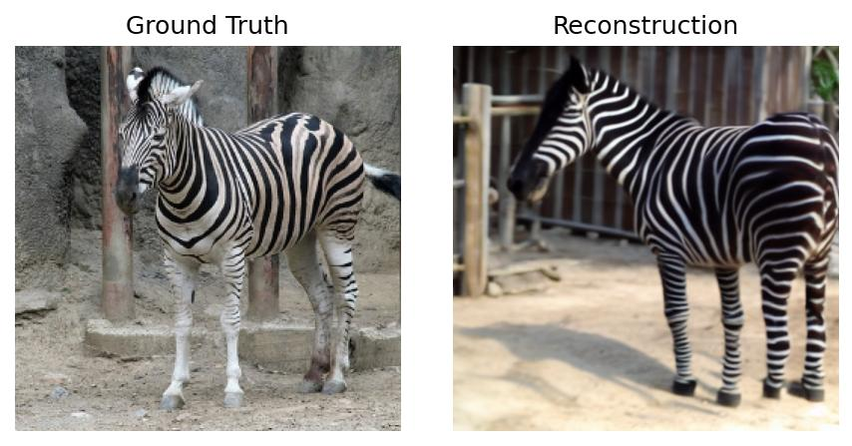
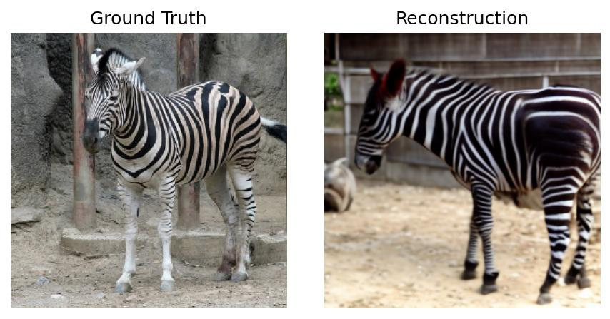
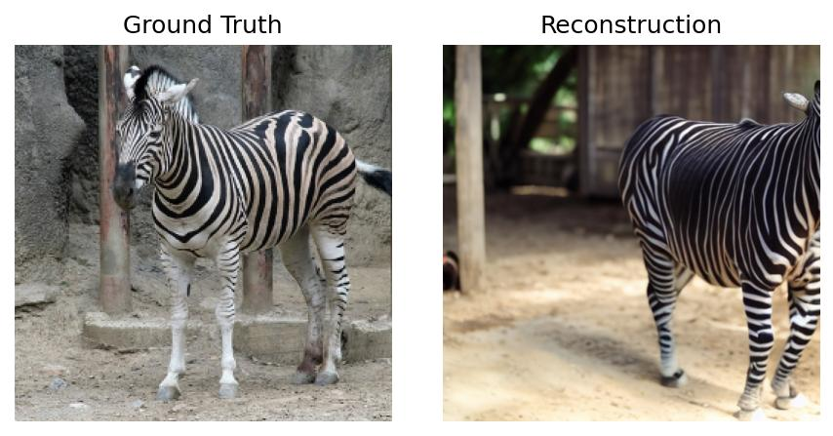
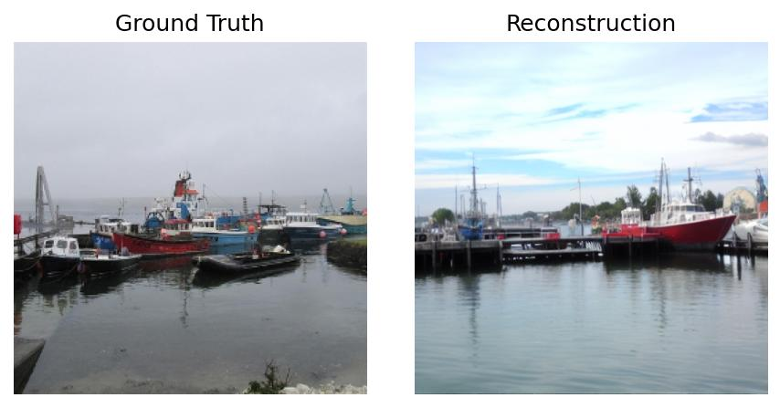
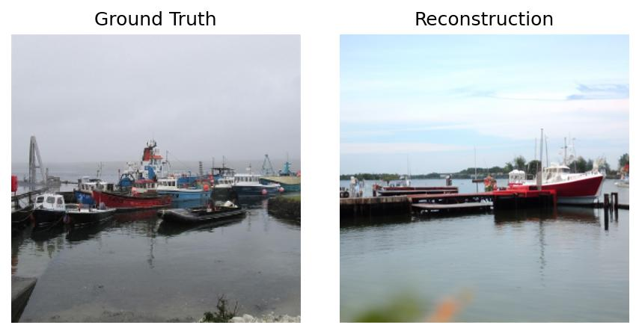
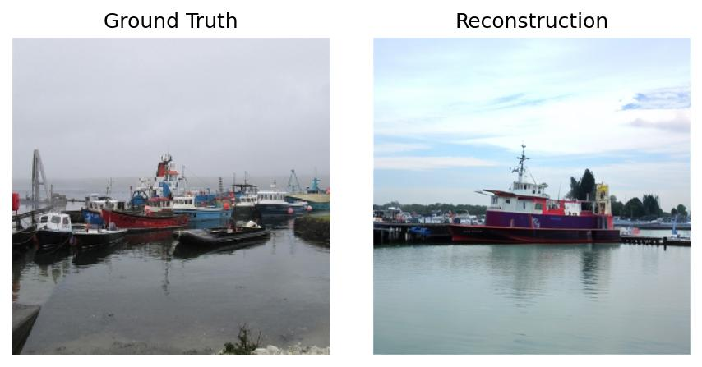
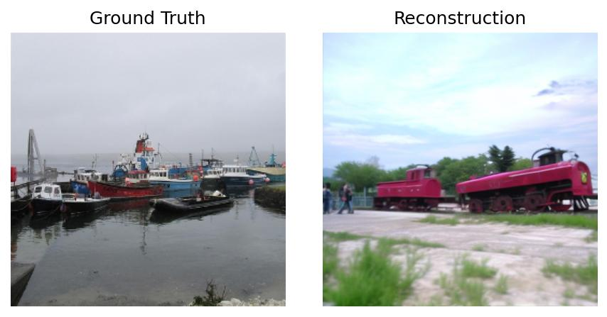
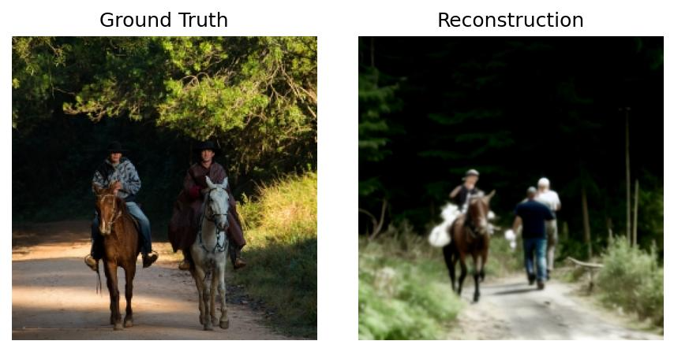
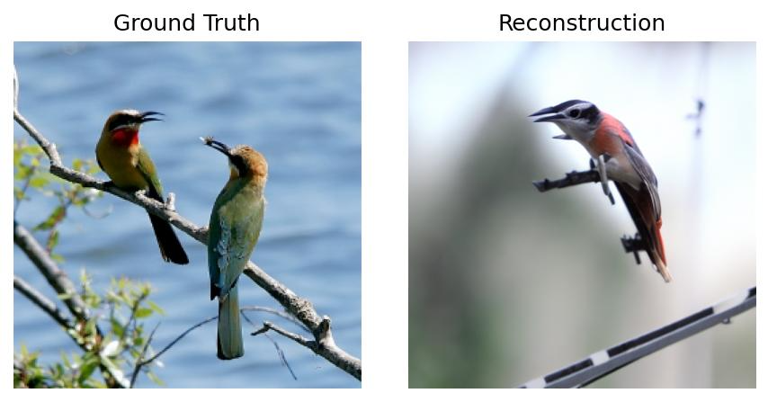
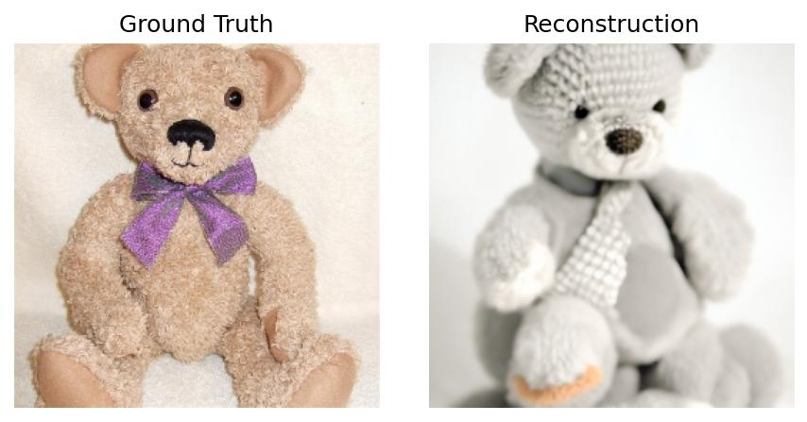
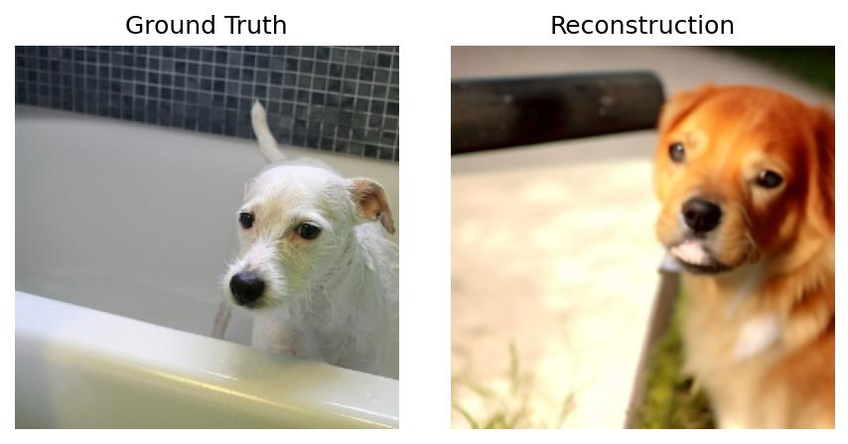
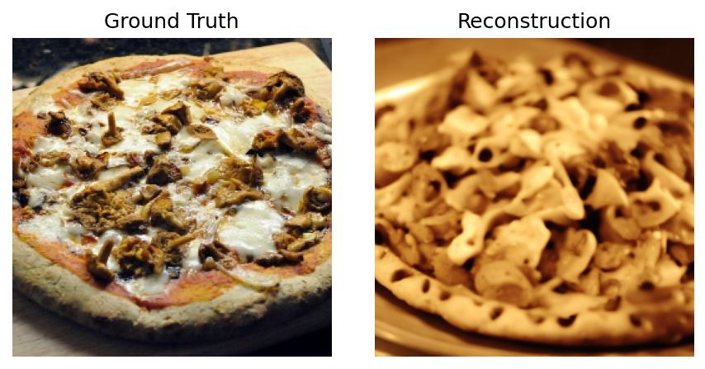
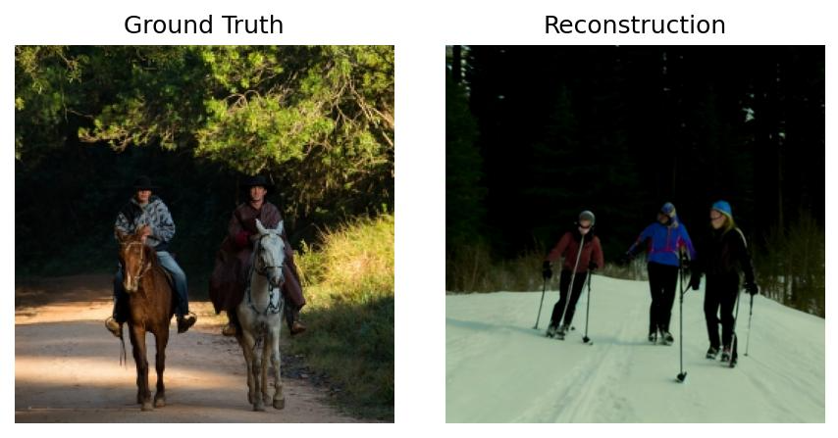
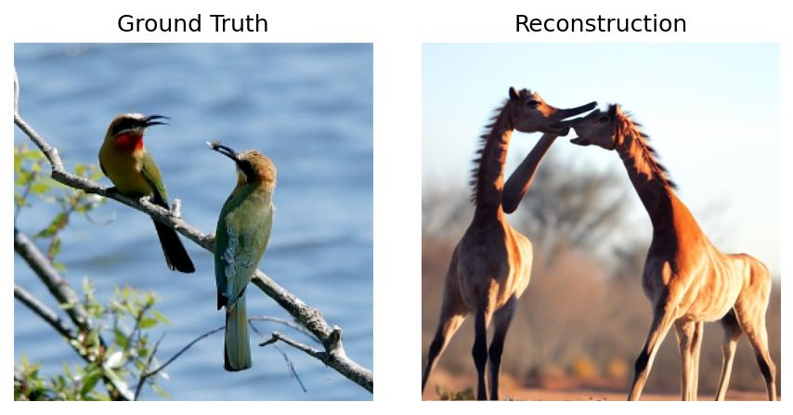
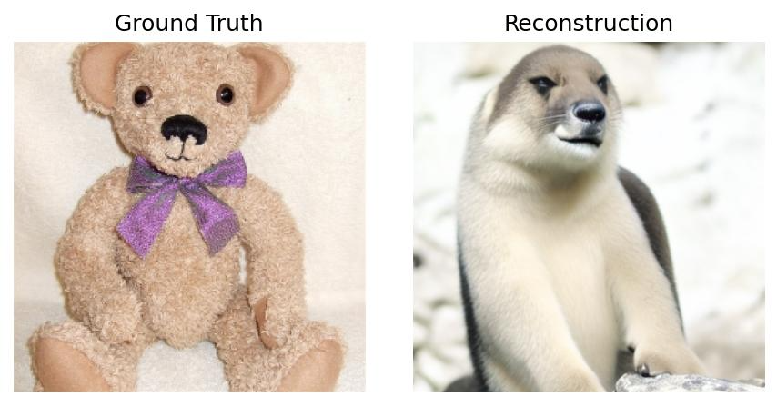
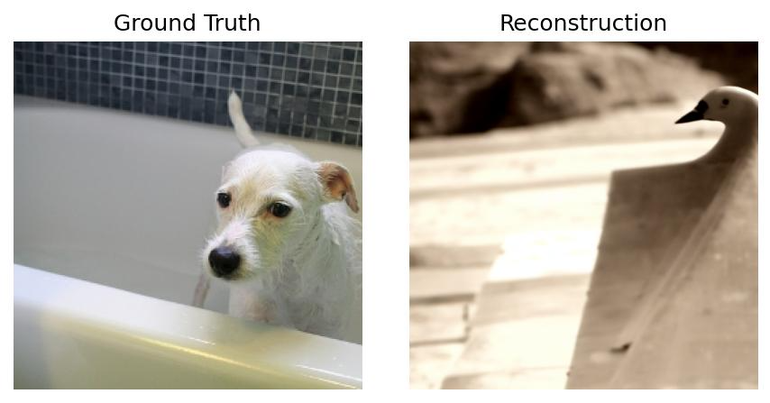
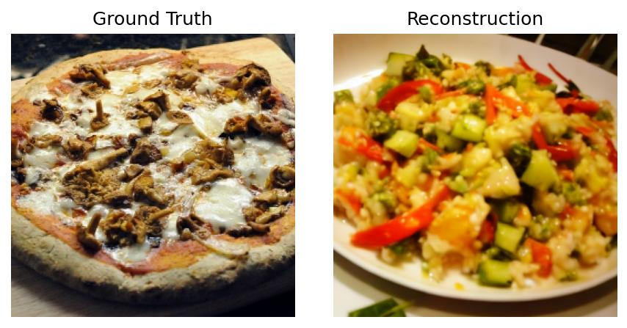
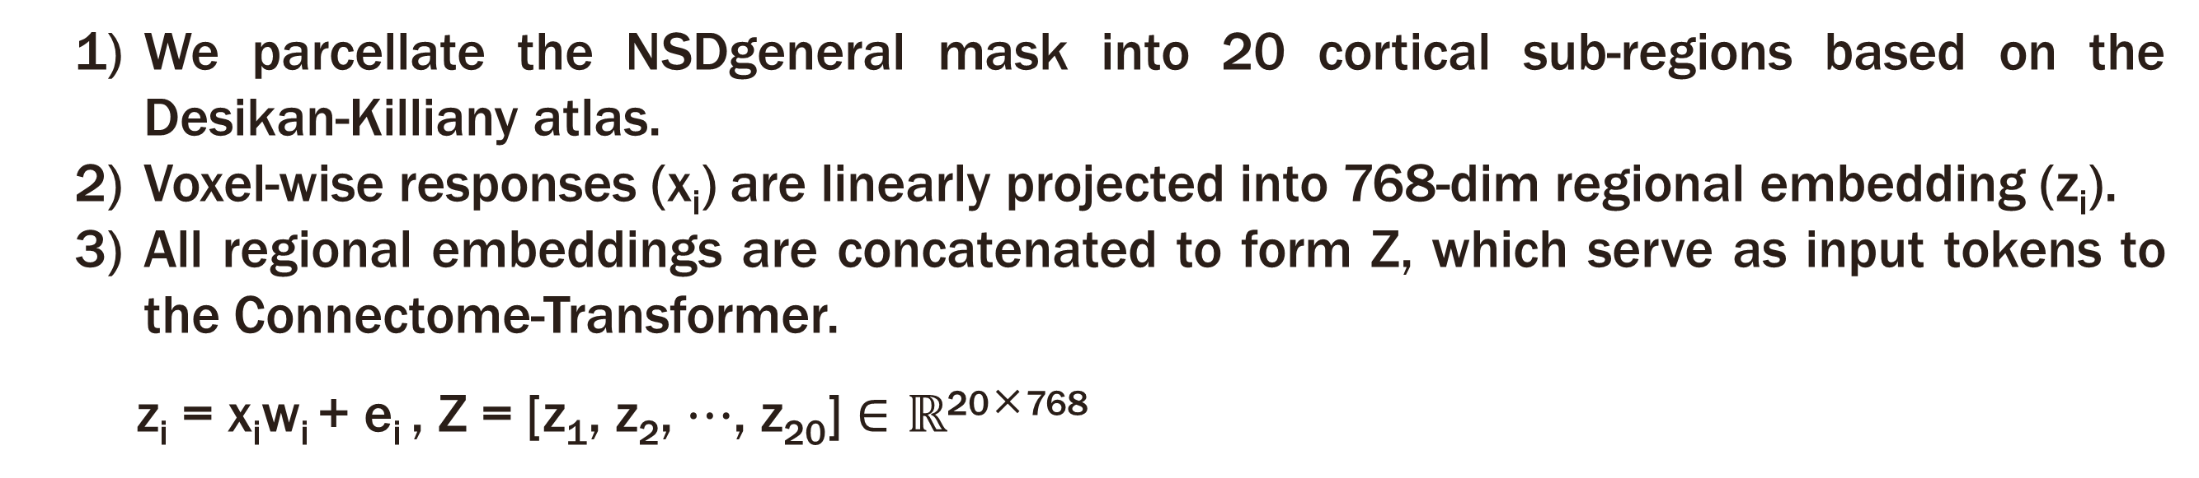




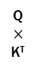
ConnecToMind: Connectome-Aware fMRI
Decoding for Visual Image Reconstruction
AI-Med Lab
MLMI2025
Gunwoo Bae^{1,†}, Yeonwoo Kim^{2,†}, and Mansu Kim^{1,3,∗}
¹ Department of AI convergence, Gwangju Institute of Science and Technology, Korea
² Department of Electrical Engineering and Computer Science, Gwangju Institute of Science and Technology, Korea
³ GIST InnoCORE AI-Nano Convergence Initiative for Early Detection of Neurodegenerative Diseases, Gwangju Institute of Science and Technology, Korea
Introduction
GitHub
Background
Current Limitation
Our Method - ConnecToMind
Reconstructing visual images from human brain activity has recently seen remarkable progress with deep learning-based decoding models.
Neuroscience studies emphasize that brain anatomical structure and inter-regional circuits are crucial for visual preprocessing.
Most recent models represent brain activity as unstructured voxel-wise signals, thereby overlooking its fine-grained anatomical and functional organization.
We propose a novel decoding framework, ConnecToMind, which integrates region-level fMRI embeddings with functional connectivity prior derived from resting-state fMRI.
Our model leverages hierarchical brain connectivity to achieve more accurate and interpretable visual reconstruction from fMRI signals.
Method
(a) Region-level embedding
Figure 1. Overview of ConnecToMind. ConnecToMind is consisted of (a) region-level fMRI embedding module and (b) Connectome-Transformer guided by FC prior.
We parcellate the NSDgeneral mask into 20 cortical sub-regions based on the Desikan-Killiany atlas.
Voxel-wise responses (x_{i}) are linearly projected into 768-dim regional embedding (z_{i}).
All regional embeddings are concatenated to form Z, which serve as input tokens to the Connectome-Transformer.
z_{i} = x_{i}w_{i} + e_{i} , Z = [z₁, z₂, $⋯$, z₂₀] $∈ℝ$^{20×768}
CLIP fMRI embedding
Reconstruction
(a) Region-level embedding
(b) Connectome-Transformer
Positional
Embedding
Versatile
Diffusion
task-fMRI
Flatten
Linear projection
Feed forward
Diffusion prior
B $×$257 $×$ 768
Versatile
Diffusion
…
…
(b) Connectome-Transformer
CLIP ViT- L/14
sub-01
FC prior
Ｖ
Linear projection
Retrieval
$$F_{1}$$
$$F_{2}$$
…
$$F_{N}$$
We extend the connectome transformer by adding FC prior into its self-attention mechanism and incorporating an inter-regional positional embedding.
Attention(Q, K, V) = softmax($\frac{\text{QK}\text{T}}{\sqrt{\text{d}\text{k}}}$＋FC)V
Q
$$×$$
K^{T}
$$I_{1}$$
$$I_{1}∙F_{1}$$
$$I_{1}∙F_{2}$$
…
$$I_{1}∙F_{N}$$
Softmax
B $×$257 $×$ 768
CLIP ViT- L/14
$$I_{2}$$
$$I_{2}∙F_{1}$$
$$I_{2}∙F_{2}$$
…
$$I_{2}∙F_{N}$$
rs-fMRI
…
…
…
…
…
Test Dataset
$$I_{N}$$
$$I_{N}∙F_{1}$$
$$I_{N}∙F_{2}$$
…
$$I_{N}∙F_{N}$$
B $×$257 $×$ 768
Contrastive Loss
Frozen
Trainable
CLIP image embedding
Denoising Loss
Results
Data description
We utilize multi-modal neuroimaging data, including T1-weighted MRI, rs-fMRI, and task-fMRI collected from Natural Scenes Dataset (NSD). We select subject 1, who completed 28,577 task-fMRI trials by viewing 9,519 unique images, each repeated three times.
fMRI-to-Image Reconstruction
Figure 2. Qualitative comparison of reconstructed images across models.
Table 1. Model Performance across low-level, high-level, and retrieval metrics.
Seen Image
ConnecToMind(Ours)
ConnecToMind-FC
ConnecToMind-FCP
MindEye
Method | Low-Level |  |  |  | High-Level |  |  |  | Retrieval
 | PixCorr | SSIM | Alex(2)  | Alex(5)  | Incep | CLIP | Eff | SwAV | Image | Brain
MindEye | .373 | .356 | 95.6% | 97.5% | 93.8% | 93.7% | .657 | .388 | 95.6% | 92.2%
ConnecToMind-FCP | .368 | .353 | 95.5% | 97.6% | 94.4% | 94.3% | .649 | .378 | 88.9% | 85.0%
ConnecToMind-FC | .370 | .355 | 95.4% | 97.7% | 94.7% | 94.4% | .645 | .378 | 93.8% | 90.8%
ConnecToMind(Ours) | .373 | .357 | 95.8% | 97.6% | 94.3% | 94.7% | .644 | .376 | 94.3% | 90.1%
Low-level perceptual fidelity evaluates how well fine details are preserved. (ConnecToMind achieves the highest scores overall)
High-level semantic accuracy measures alignment with semantic content. (ConnecToMind achieves the highest scores overall)
Retrieval score measures how well fMRI embeddings match to corresponding stimuli embeddings. (ConnecToMind achieves performance comparable to MindEye)
Impact of Visual Cortical Sub-regions
Figure 3. Visualization of fMRI-to-image reconstruction for ConnecToMind-L, and H.
Table 2. Impact of sub-regional visual cortex on image reconstruction
Seen Image
Method | Low-Level |  |  |  | High-Level
 | PixCorr | SSIM | Alex(2)  | Alex(5)  | Incep | CLIP | Eff | SwAV
ConnecToMind | .373 | .357 | 95.8% | 97.6% | 94.3% | 94.7% | .644 | .376
ConnecToMind-L | .367 | .350 | 95.0% | 97.4% | 94.1% | 94.2% | .656 | .384
ConnecToMind-H | .372 | .353 | 95.6% | 97.1% | 92.7% | 93.4% | .669 | .392
ConnecToMind-L
ConnecToMind-L : excludes early visual regions
(Early visual regions, including V1-V3, primarily encode low-level perceptual details)
ConnecToMind-H : excludes higher-order visual regions
(Higher-order regions such as Lateral Occipital, Fusiform specialize in semantic processing)
ConnecToMind-H
Acknowledgments This work was partly supported by the NRF grant funded by the Korean government (No. RS-2025-00521250), by the IITP grants funded by the Korean government (No. RS-2021-II212068, Artificial Intelligence Innovation Hub; No. 2019-0 01842, Artificial Intelligence Graduate School Program [GIST], No.2022–0–00448/RS 2022-II220448, Deep Total Recall: Continual Learning for Human-Like Recall of Artificial Neural Networks), by the MOTIE under the “Infrastructure Program for Industrial Innovation” supervised by the Korea Institute for Advancement of Technology (KIAT) (No. RS-2024-00434342), and by InnoCORE-GIST program of the Ministry of Science and ICT.

